Slide 1

An Approach to Automatic Object Tracking System by Combination of SIFT and RANSAC with Mean Shift and KLT
A STORY OF MY NOTEBOOK
Fu Yuqian
October 12, 2018
许文滔
Dec 14, 2018
2016 Conference on Advances in Signal Processing (CASP)

Slide 2
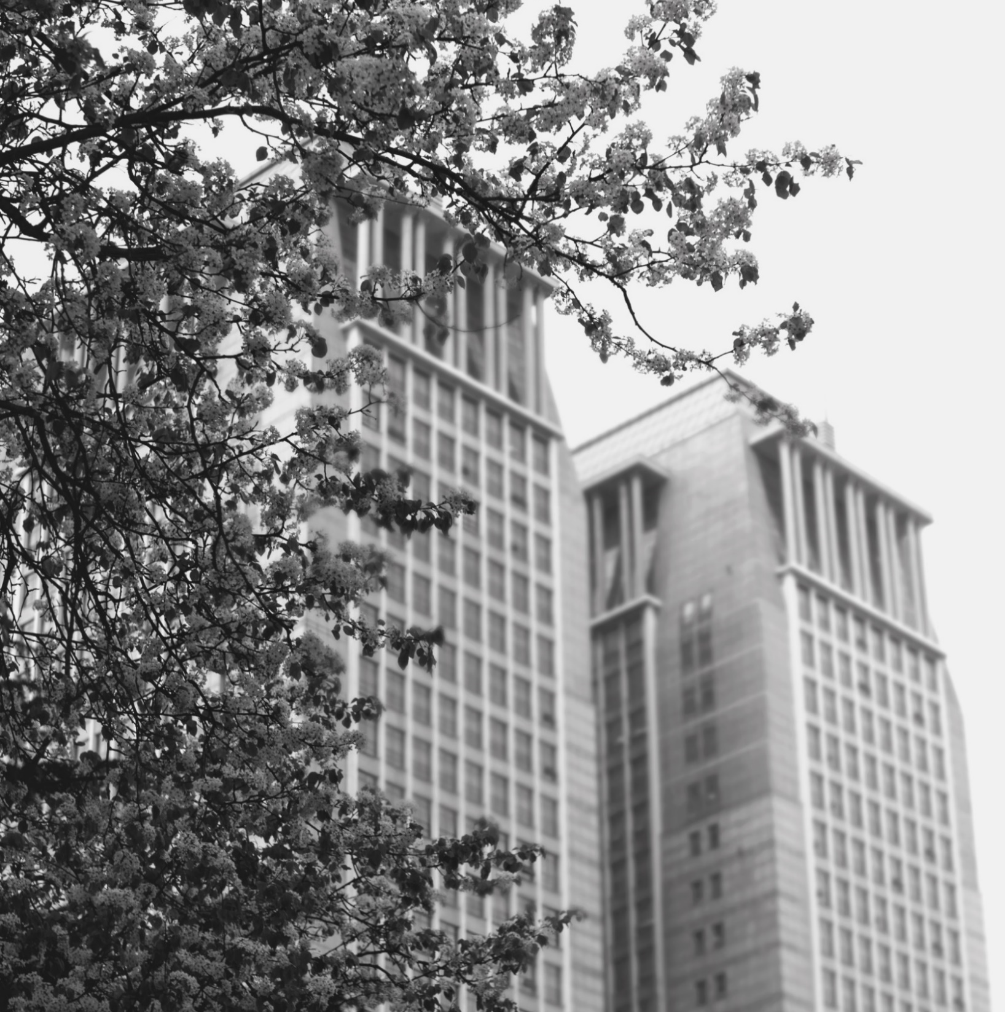
Introduction
1

Slide 3
Object recognition
Challenges in object recognition?
Humans can recognize a multitude of objects in images easily even though they may vary in scale, size, alignment, view points or they may be partially obstructed.
But algorithmic description of this task for implementation on machines has been very difficult. Difficulties in object recognition arise due to occlusion, clutter and geometric transformations present between pair of images or frames.

Slide 4
Object tracking
Challenges in object tracking?
The aim of object tracking is to determine the position of the object in video frames continuously and reliably against dynamic scenes i.e. to associate target objects in consecutive frames.
Challenges in tracking include ability to deal with abrupt object motion, nonrigid object structures, change in appearance patterns of scene and object, occlusions present and camera motion.

Slide 5
Object recognition and tracking
temporal differencing
Disadvantage
based upon assumption of static background
sensitive to illumination changes, shadow, wind, rain etc.
background subtraction.

Slide 6
Mean Shift algorithm for real time tracking of non-rigid objects
Advantage:
The tracker had capability to handle real time occlusions and signiﬁcant clutter.
Disadvantage:
But for selection of target, authors suggested to draw ellipsoidal or rectangular region manually on the ﬁrst frame.

Slide 7
SIFT based Mean Shift algorithm for object tracking (2008)
Advantage:
Tracking performance was improved compared to original Mean Shift algorithm .
Disadvantage:
But selection of region of interest was again a manual process.

Slide 8
Video Surveillance
Detection of region of interest is the ﬁrst step of information extraction and should be automatic.

Slide 9
Scale Invariant Feature Transform
FSIFT
Characteristics
best under scale and rotation changes
PCA-SIFT
CSIFT
Characteristics
GSIFT
under illumination and blur change, GSIFT performs best.

Slide 10
Object recognition and tracking
used to automatically detect the object in ﬁrst frame of video
Using SIFT features and RANSAC for estimating geometrical transformation
make tracking system fully automatic
Mean Shift and KLT.

Slide 11
OBJECT RECOGNITION WITH SIFT AND RANSAC
2

Slide 12
OBJECT RECOGNITION WITH SIFT AND RANSAC
Feature Extraction
Feature Matching
Homography Estimation with RANSAC

Slide 13
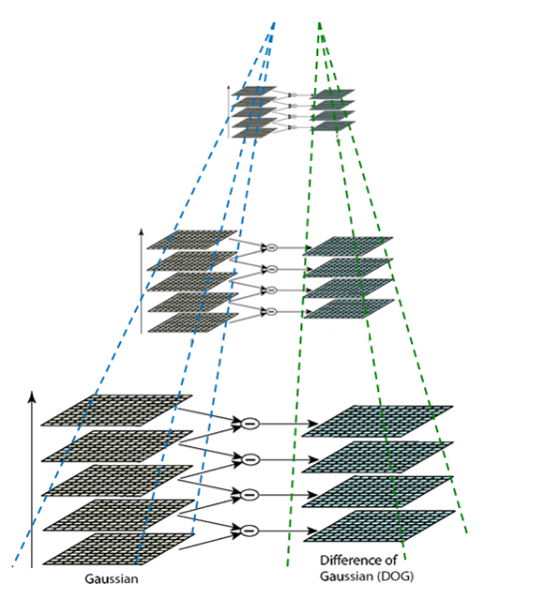
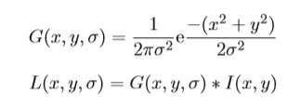
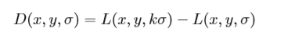
Feature Extraction
Scale Space Construction

Slide 14
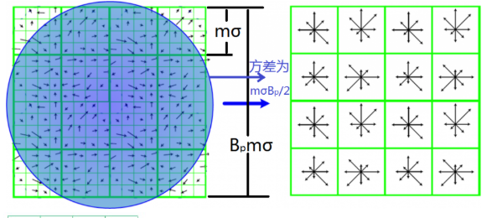
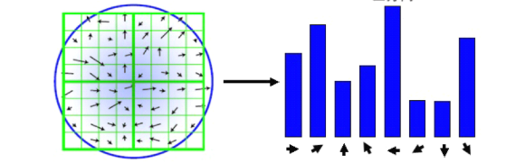
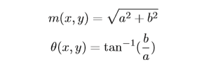
Feature Extraction
Keypoint Localization
Orientation Assignment
Keypoint Descriptor

Slide 15
Feature Matching
it becomes quite slow when large number of features exist and hence is less efﬁcient.
euclidean distance based approach
cosine similarity based approach.

Slide 16
Homography Estimation with RANSAC
The basic steps of algorithm :
1) Randomly select any four pairs of feature matches to estimate the homography as four points are required for plane ﬁtting.
2) Estimate homography matrix by Direct Linear Transform.
3) Calculate how many points are inliers.
4) Calculate the ratio of number of inliers to the total number of points present in set.
5) If this ratio is greater than the predeﬁned ratio T, then again estimate the homography matrix / model parameters using all the identiﬁed inliers and terminate. Otherwise repeat steps 1 to 4 (for N iterations)

Slide 17
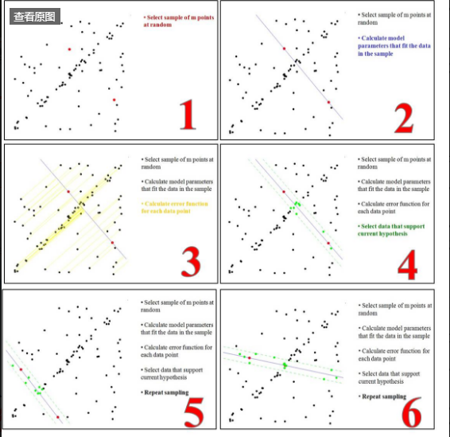
Homography Estimation with RANSAC

Slide 18
OBJECT TRACKING WITH MEAN SHIFT AND KLT TRACKER
3

Slide 19
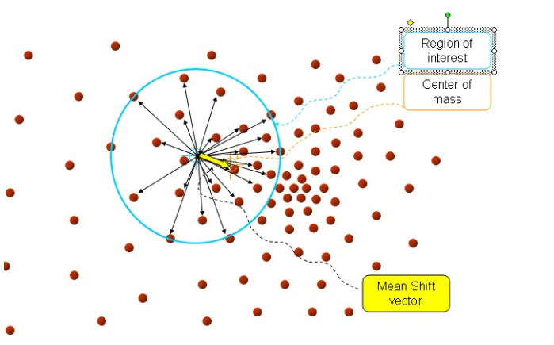
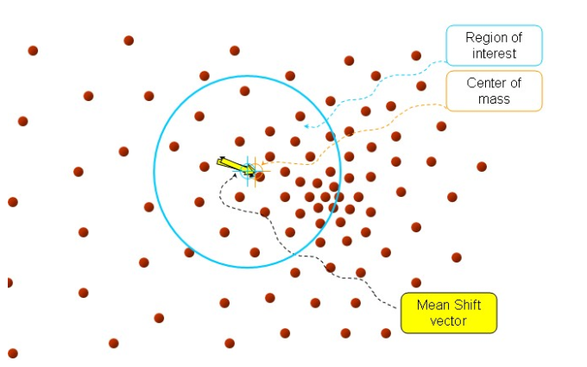
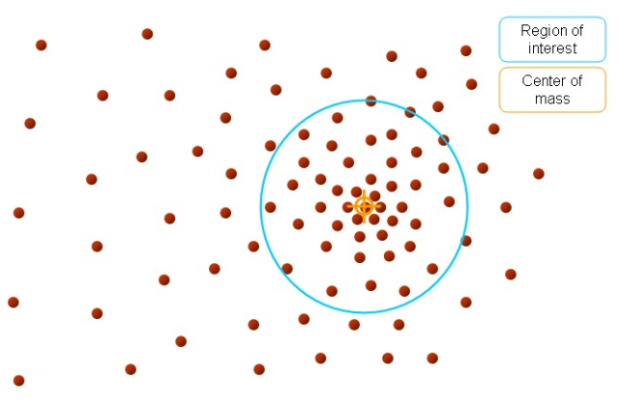
Mean Shift
Mean Shift can track the object even in presence of occlusion and clutter. However, it is not scale adaptive. Next, we will see KLT tracker which overcomes this drawback.

Slide 20
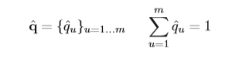
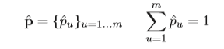
Mean Shift
Calculate candidate probability density function (weighted color histogram) p in the same way as q is calculated.
Next step is to model the target in feature space. Here, the object is being modeled using weighted colour histogram. Weights are assigned using Gaussian kernel. Probability density function of target is denoted by q.
Define Region of Interest in the first frame of video. We are selecting it automatically, by SIFT and RANSAC as explained earlier，
Initialize the estimated position of target in the next framesameasincurrentframei.e. y1 = y0 and x1 = x0.

Slide 21
KLT Tracker
It is a classic corner tracking algorithm. The algorithm assumes that the target is in the video stream, only produces a consistent small displacement, and the target's gray level does not change much.

Slide 22
KLT Tracker
three assumptions
The brightness is constant
Time continuous or small motion displacement
Spatial consistency, adjacent points have similar motion and remain adjacent.
guarantees that the target is not affected by the brightness
ensure that the feature points can correspond in the target domain
ensure that all points have the same displacement within the same window

Slide 23
Experiments
4

Slide 24
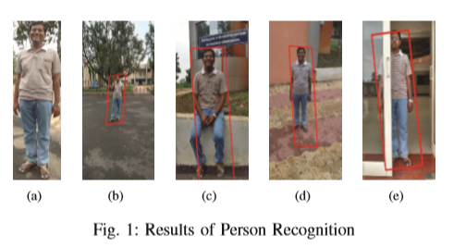
Experiment：Person Recognition
Fig. 1 shows sample results of person recognition. Fig. 1(a) is used as training image for the person recognition in a set of images. We can see that person is correctly recognized when it is at different scale than the reference image as shown in ﬁg. 1(b). Fig. 1(c) shows a case when there is change of pose. In ﬁg. 1(d), projective transformation exists i.e. there is change in 3D viewpoint. Result of recognition in presence of partial occlusion is shown in ﬁg. 1(e).

Slide 25
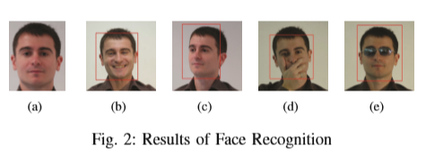
Experiment：Face Recognition
Training image of the person used for face recognition is shown in fig. 2(a). Fig. 2(b)-(e) show that face is correctly recognized irrespective of illumination changes that are present among the images as well as facial expression and pose variation. Even though part of face is covered by hand or goggle in fig. 2(d) and 2(e), face is successfully recognized.

Slide 26
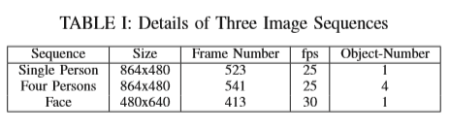
Experiment：Person Recognition

Slide 27
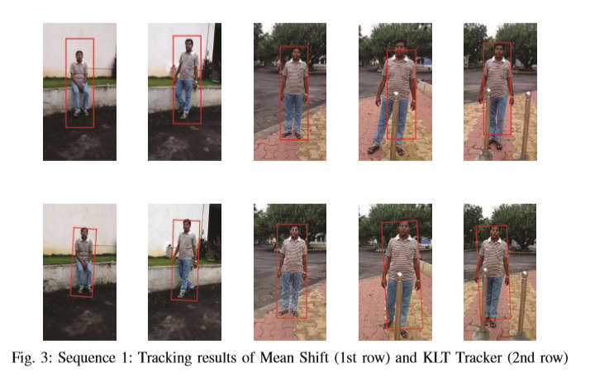
Tracking results of Mean Shift and KLT Tracker

Slide 28
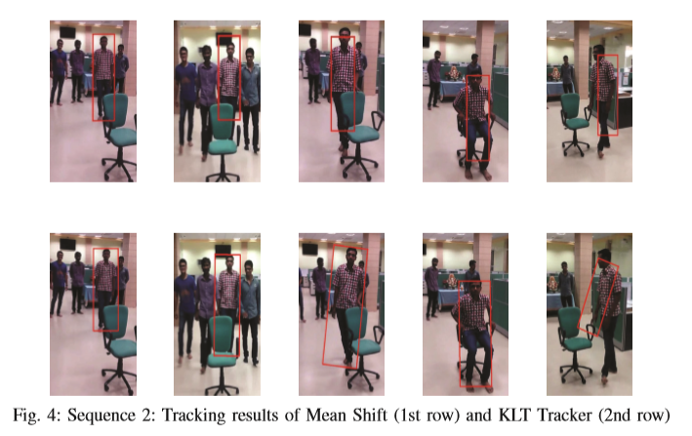
Tracking results of Mean Shift and KLT Tracker

Slide 29
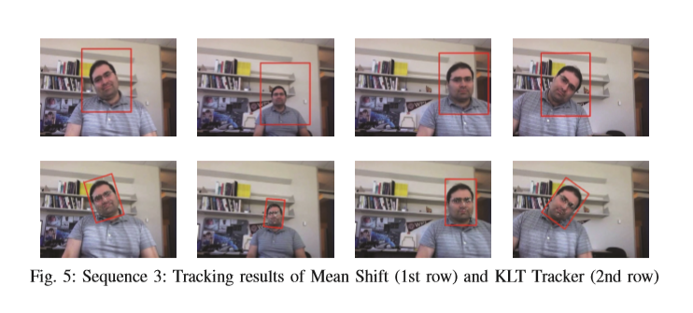
Tracking results of Mean Shift and KLT Tracker

Slide 30
Conclusion
5

Slide 31
Conclusion
Mean Shift, KLT has the ability to handle partial occlusion.
Mean Shift:
1. The size of the rectangle is not adaptive, ie the size of the rectangle remains unchanged.
2. The mean shift tracking algorithm is based on the color information of the object. If the object's interest and background color are similar, then the mean shift may not be able to identify and track the real object.
KLT:
1. It can handle the scale change of the object. In other words, the size of the rectangle as well as the size and direction of the object change its direction.
2. It can also track the success of an object even when the color of the object and the background are similar.
3. However, KLT is more complex, so its execution time is also higher than the mean shift.

Slide 32
THANKS

